Slide 1



2024 Single Cell Workshop Colombia: Day 5- 10X downstream, QC results, sequencing, and lessons learned
July 12-15, 2024
Bogota, Colombia

Slide 2
Steps from yesterday
Honeycomb CLX
10X Genomics
Post-library prep spri clean up
QC
Recovery beads post-incubation
pre-amplification PCR
Spri clean up
Sample indexing + PCR
Spri clean up
Library QC

Slide 3
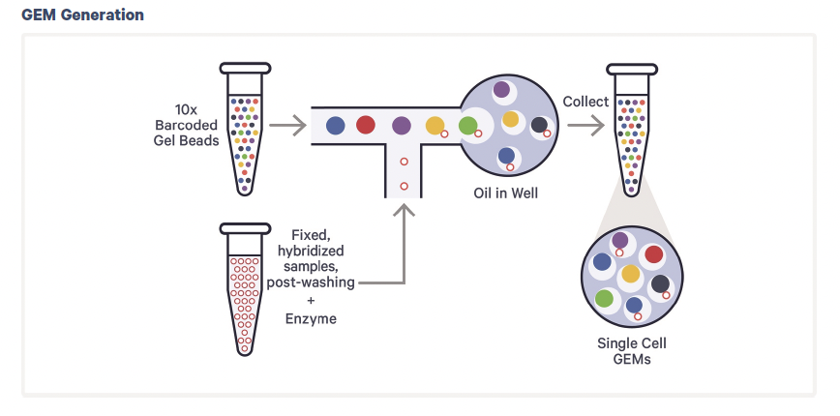
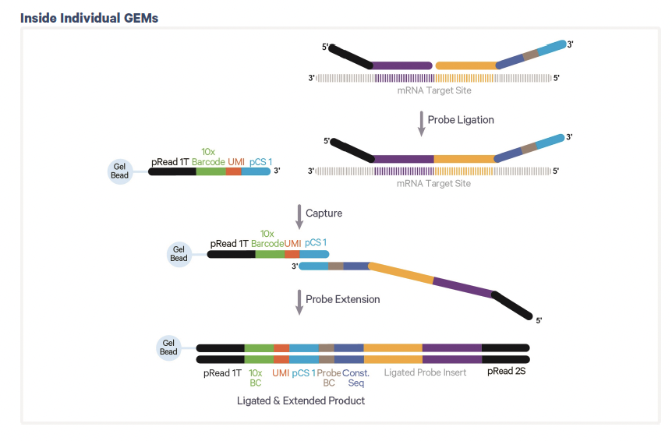
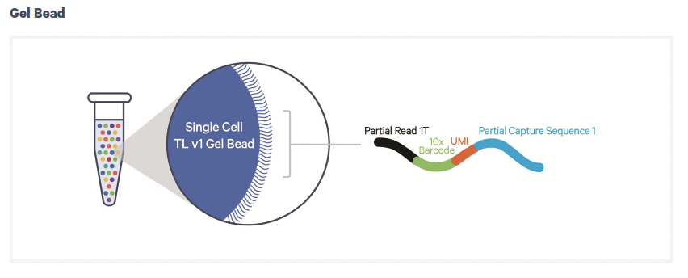
Wednesday: Chromium Fixed RNA Profiling GEM Generation

Slide 4
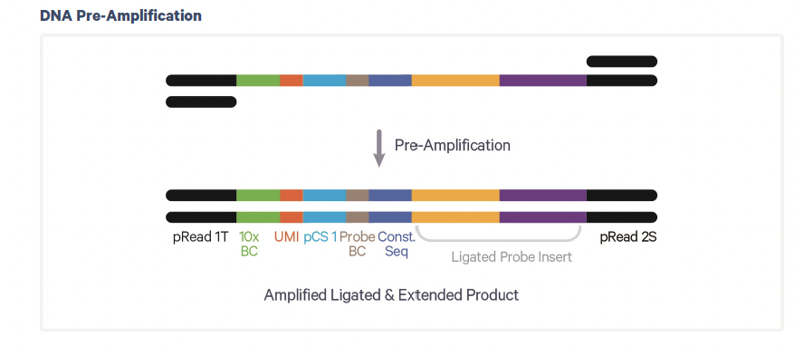
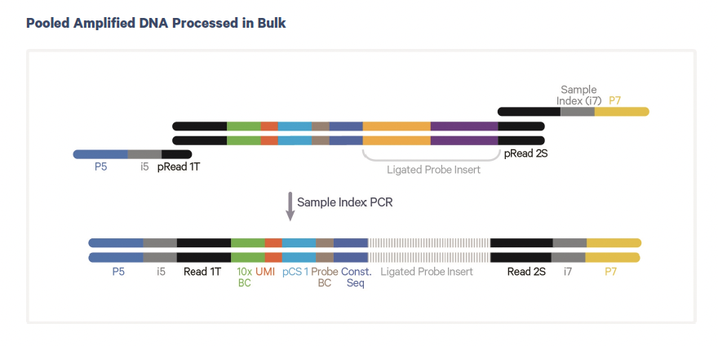
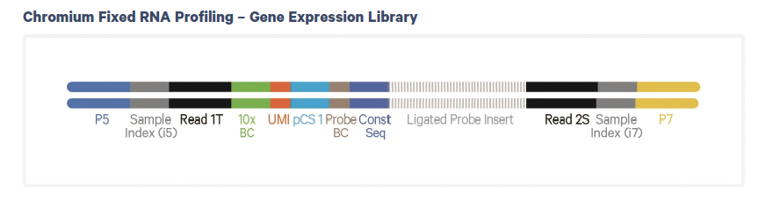
Yesterday: Pre-Amplification, Library prep

Slide 5
Tape Station Expected Results (from protocols)

Slide 6
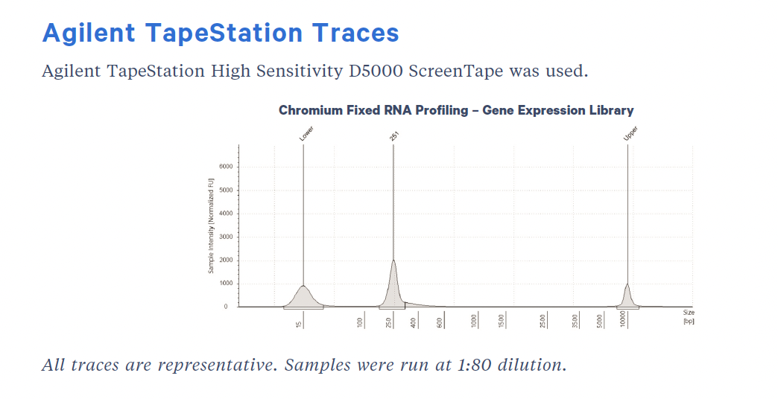
10X Fixed protocol representative tape (from protocol)

Slide 7
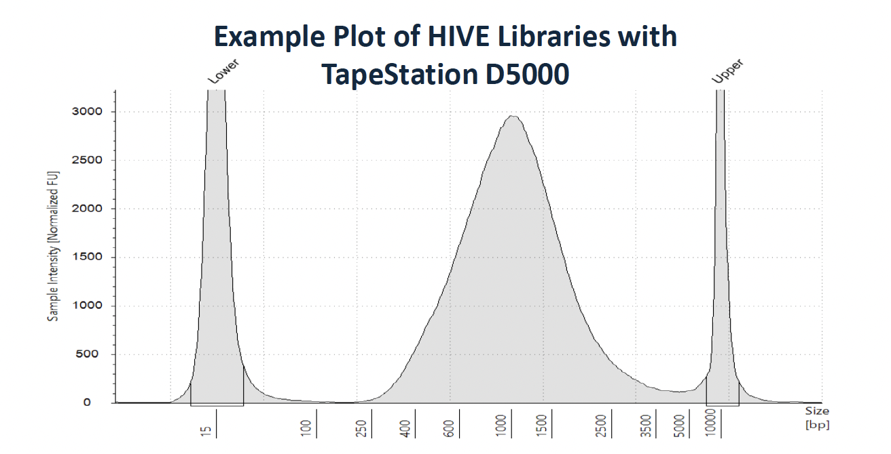
Honeycomb CLX protocol representative tape (from protocol)

Slide 8
What did we do this week?

Slide 9
Overview single cell workflow
Sample Preparation
mRNA Capture
1st & 2nd Strand Synthesis
WTA (PCR)
Library Prep

Slide 10
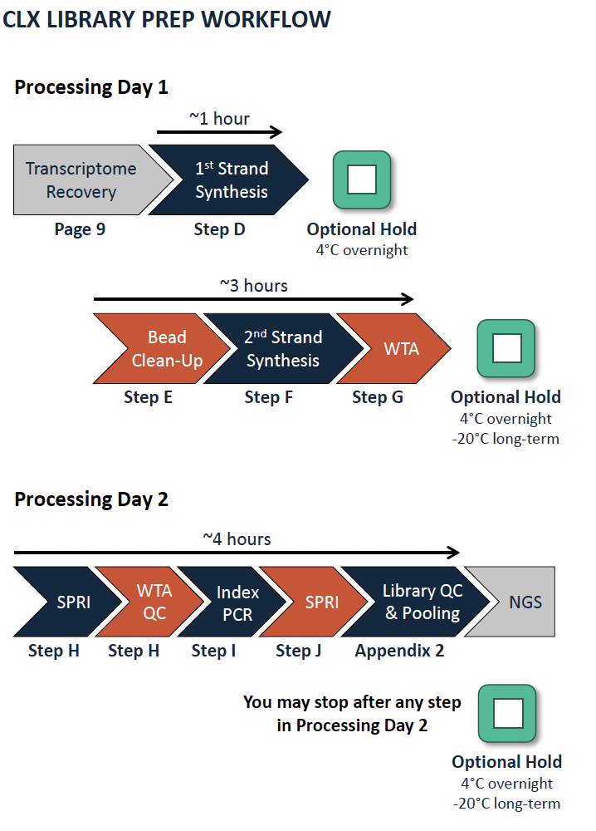
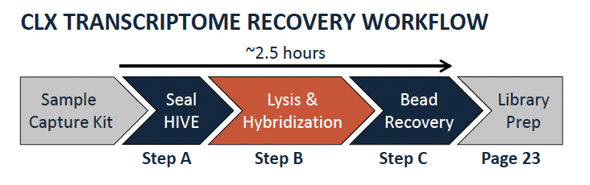
Honeycomb Overview

Slide 11
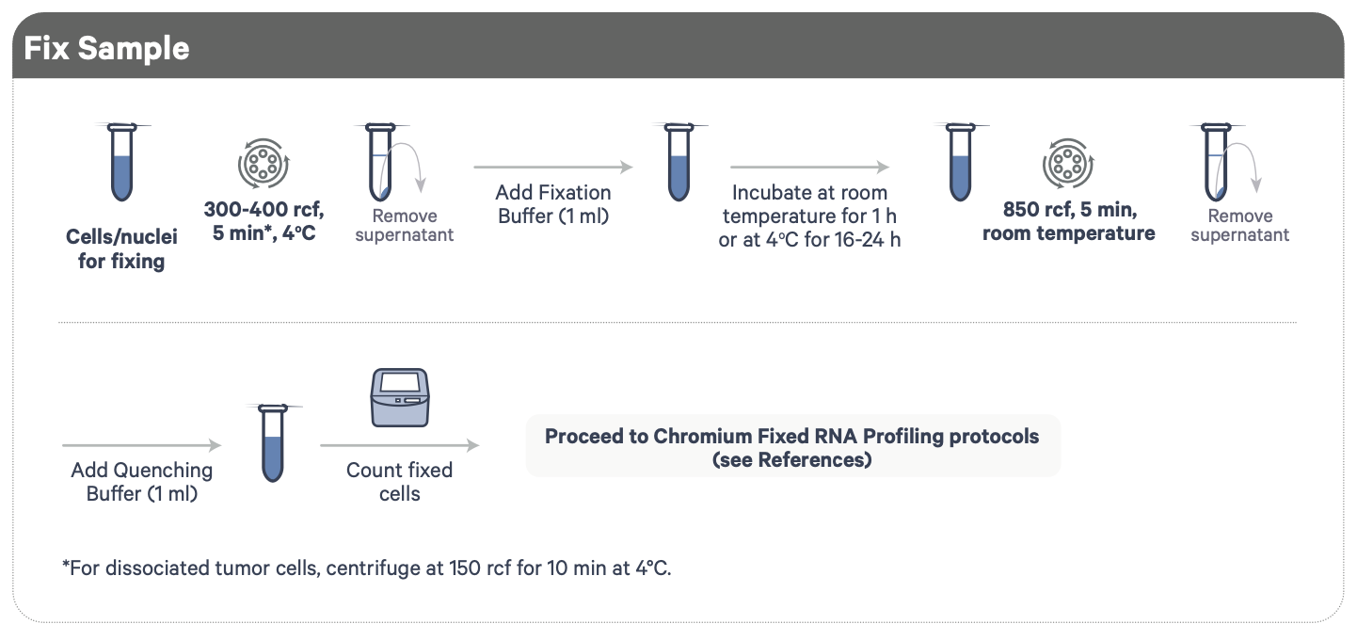
Cell Fixation for 10X

Slide 12
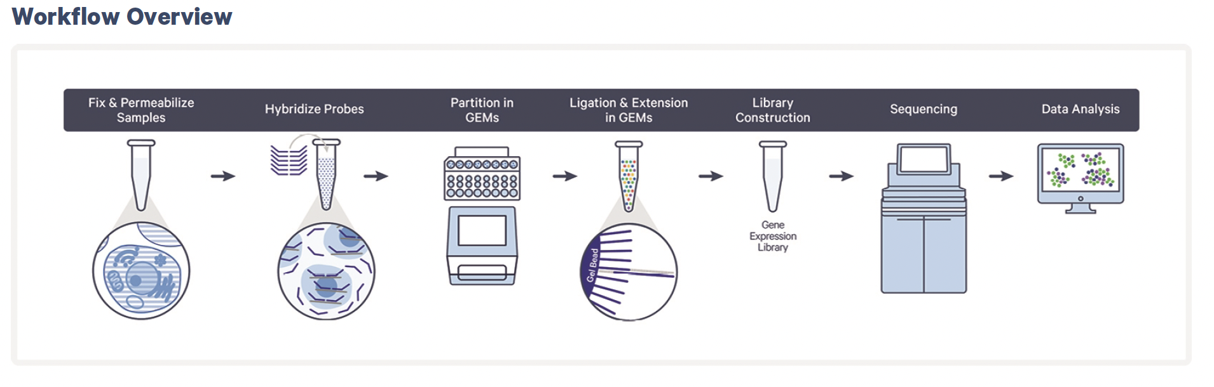
10X Fixed RNA Protocol

Slide 13
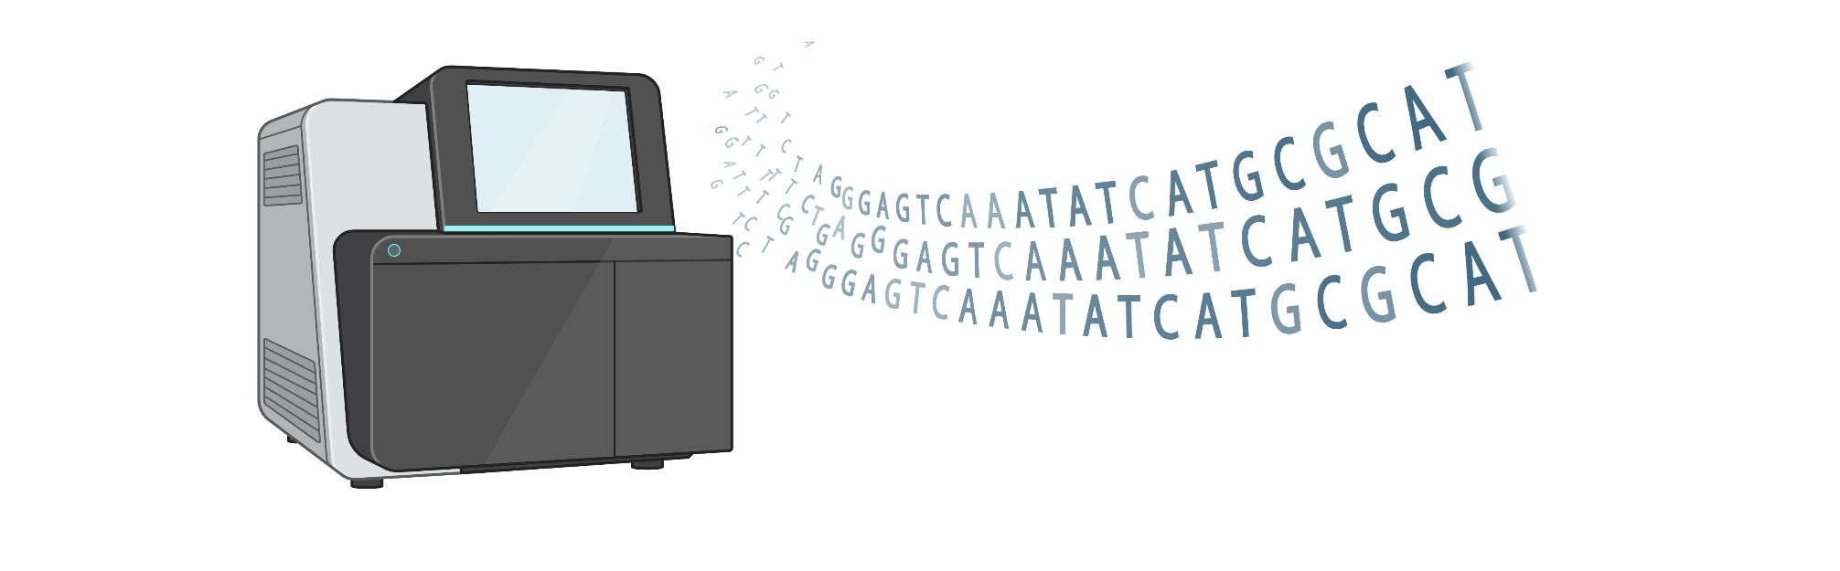

Sequencing Considerations

Slide 14
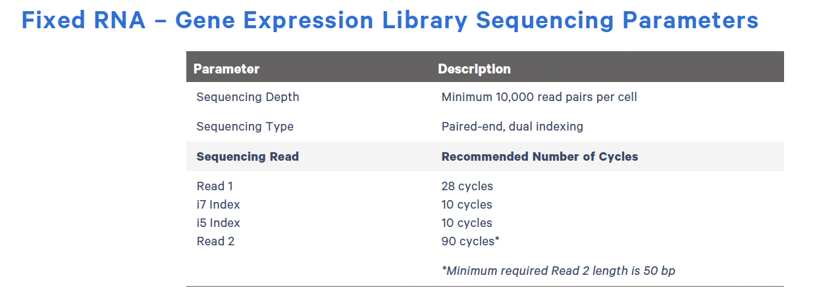
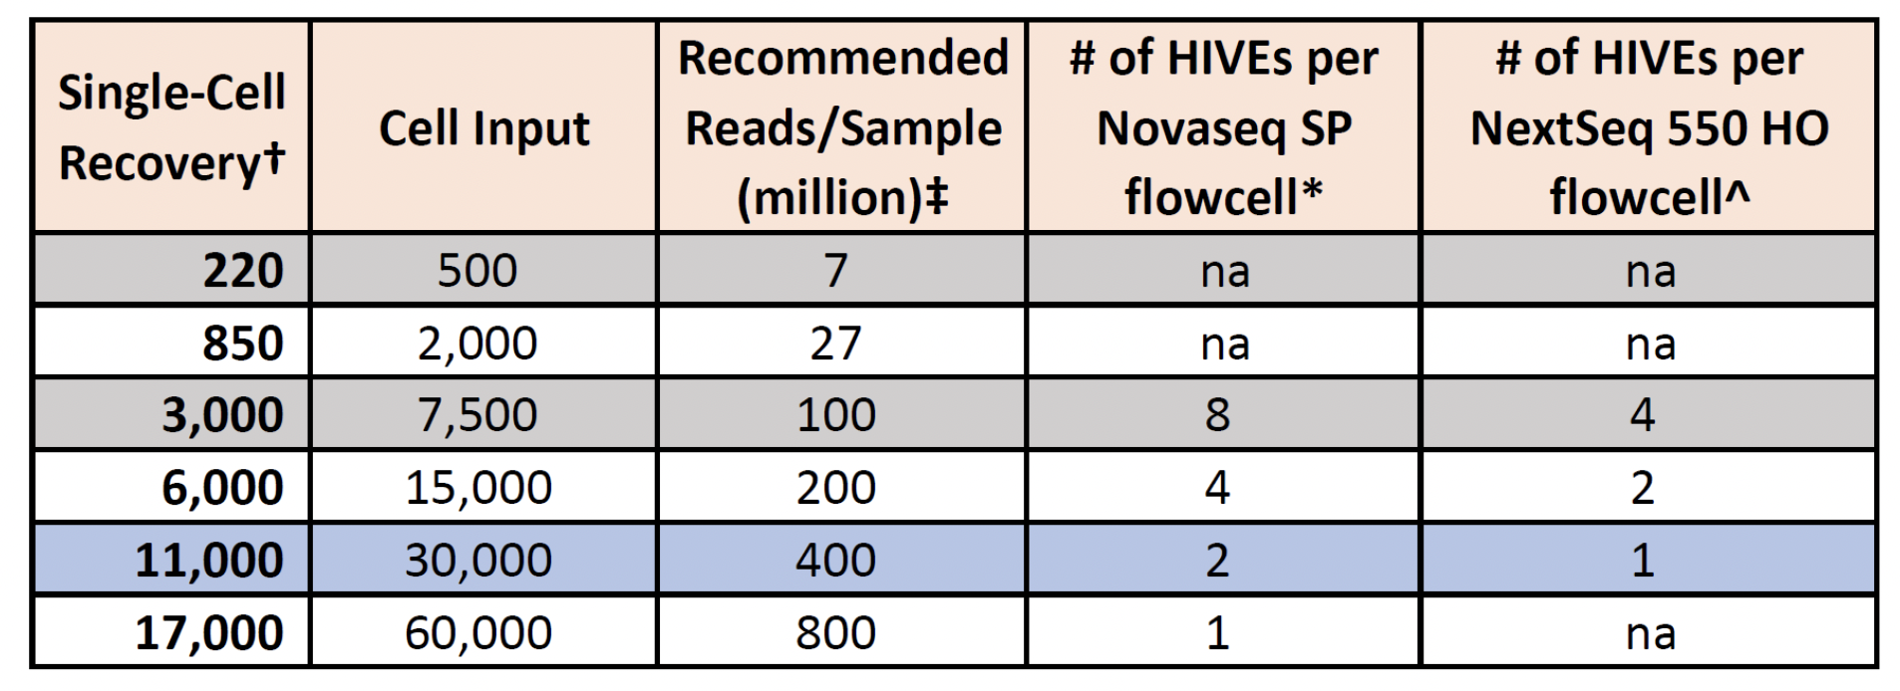
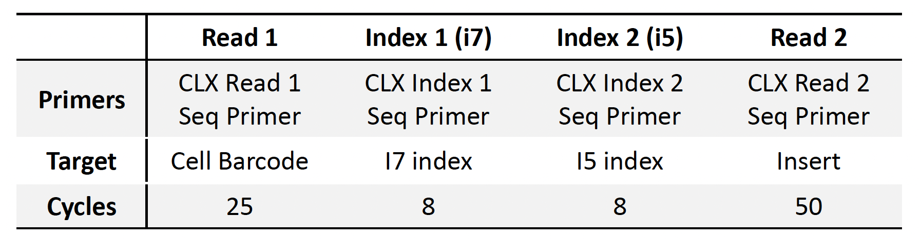
Protocol specific factors: read structure and sequencing depth
10X Fixed RNA
Honeycomb CLX

Slide 15
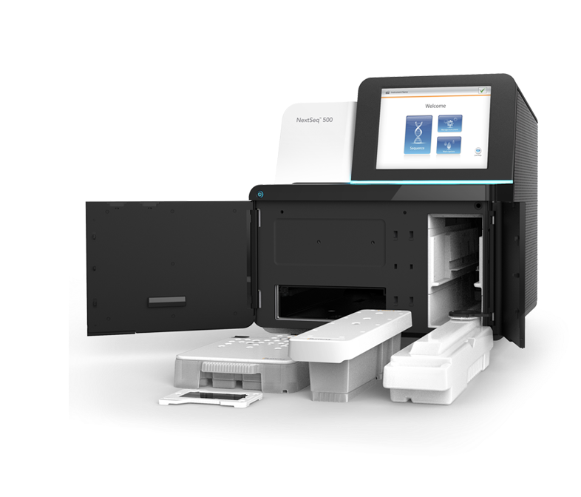
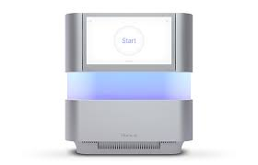
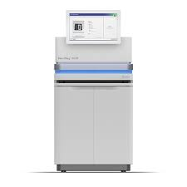
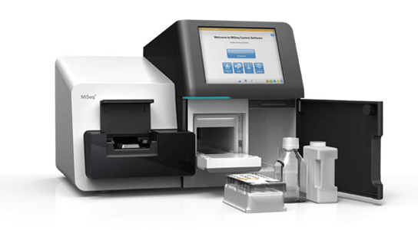

Sequencers
MiSeq
NextSeq 500
NextSeq 2000
NovaSeq
~20M reads
~ 500M Reads
~ 1.2B Reads
~ 6, 10 or 25B Reads
Price

Slide 16
Sequencing considerations: choosing a sequencer
What type of sequencer do you have access to?
What is your budget?
How many samples do you have that can be sequenced together? (remember indexes and read structure)
How many reads do you need?

Slide 17
How do I pool my samples?
1. Decide which samples you are pooling (consider which samples have compatible read structure and indexes)
2. Decide the ratio you want to pool your samples (most commonly pool evenly, but if expecting different cell outputs then pool in proportion)
3. Determine the pool concentration and volume you need for your sequencer (e.g. 5 uL pool at 4nM for NextSeq500)
4. Calculate the current nM concentration for each sample from tape/qubit/BioA
5. Combine samples at determined ratio of moles
6. Tape/qubit/BioA sample
7. Dilute to proper concentration for sequencer
Example:
I have two samples that I want to pool equally for a NextSeq500 run. Sample 1 is at 9 nM and Sample 2 is at 4.5nM. How should I pool?
To make sure I have enough volume to load, I will use 2 uL of my most concentrated sample (Sample 1), I will then add twice as much volume of Sample 2, so 4 uL, because the concentration is half that of Sample 1. I will then QC and dilute to 4nM.

Slide 18
Lessons from this week!
There is more than one way to do single cell
Cell lines are easier to work with than biopsies
Understanding what is happening in each step of the protocol is very helpful! And helps with troubleshooting!
Even when things don’t look perfect you can still achieve good data- so keep going!
You can do single cell!

Slide 19
Thanks so much for spending the week with us, we truly enjoyed working with you and hope our paths cross again the in the future! If you have questions or want to talk through experimental plans/idea/questions, please feel free to contact us! Everyone you met from the Shalek Lab has their contact info up to date on https://shaleklab.com/team/nucleus/

Slide 20
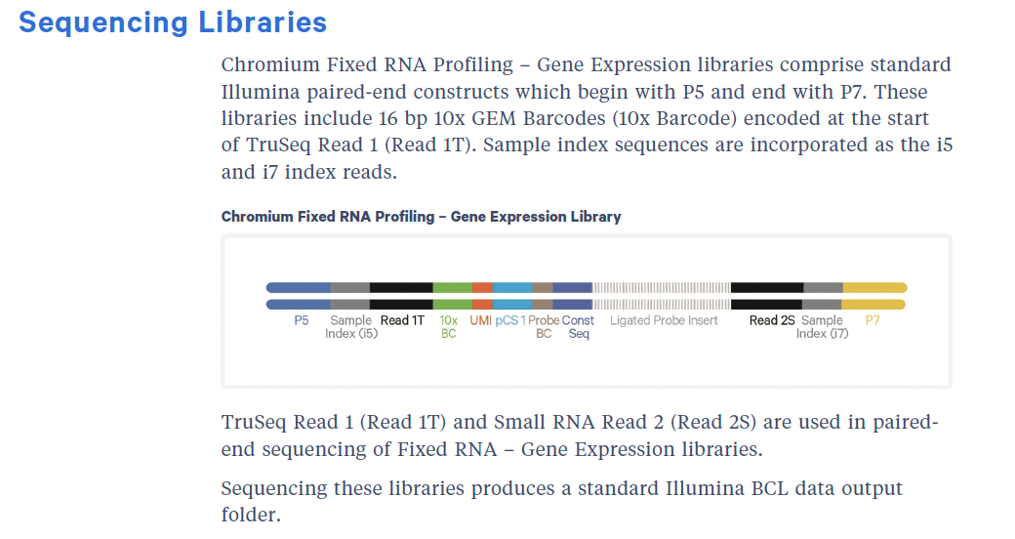

Slide 21
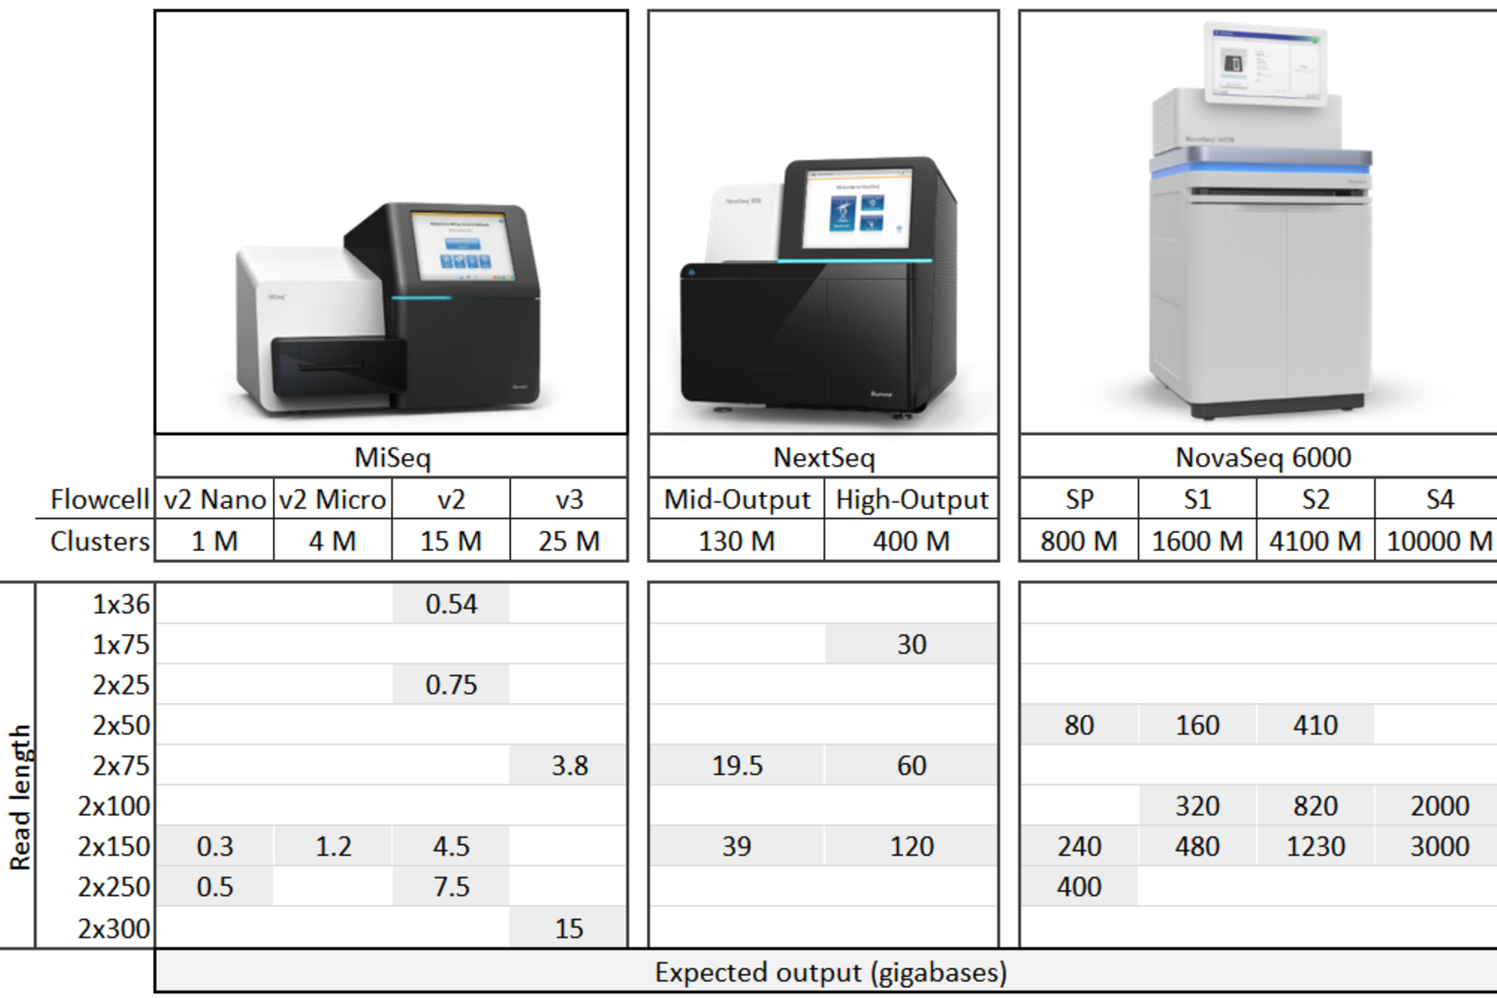
Sequencing

